Slide 1

APEX INSTITUTE OF TECHNOLOGY
DEPARTMENT OF COMPUTER SCIENCE & ENGINEERING
Database Management System (22CSH-243)
Faculty: Ms. Shaveta Jain (13464)
Lecture - 1
Overview of Databases
DISCOVER . LEARN . EMPOWER

Slide 2
DBMS: Course Objectives
COURSE OBJECTIVES
The Course aims to:
Understand database system concepts and design databases for different applications and to acquire the knowledge on DBMS and RDBMS.
Implement and understand different types of DDL, DML and DCL statements.
Understand transaction concepts related to databases and recovery/backup techniques required for the proper storage of data.

Slide 3
COURSE OUTCOMES
On completion of this course, the students shall be able to:-
CO1 | Understand the database concept, system architecture and role of database administrator

Slide 4
Unit-1 Syllabus
Unit-1 | Introduction to Databases and Relational Algebra
Overview of Databases: | Database concepts, DBMS, Data Base System Architecture (Three Level ANSI-SPARC Architecture), Advantages and Disadvantages of DBMS, Data Independence, DBA and Responsibilities of DBA, Relational Data Structure, Keys, Relations, Attributes, Schema and Instances, Referential integrity, Entity integrity.
Data Models: | Relational Model, Network Model, Hierarchical Model, ER Model: Design, issues, Mapping constraints, ER diagram, Comparison of Models
Relational Algebra & Relational Calculus: | Introduction, Syntax, Semantics, Additional operators, Grouping and Ungrouping, Relational comparisons, Tuple Calculus, Domain Calculus, Calculus Vs Algebra, Computational capabilities

Slide 5
Outline
Overview of Databases
Database concepts, DBMS,
Importance of DBMS
Advantages and Disadvantages of DBMS
DBA and Responsibilities of DBA

Slide 6

Common Terminologies
Data: Facts, figures, statistics etc. having no particular meaning (e.g. 1, ABC, 19 etc).
Record: Collection of related data items, e.g. in the above example the three data items had no meaning. But if we organize them in the following way, then they collectively represent meaningful information.
https://beginnersbook.com/2015/04/e-r-model-in-dbms/

Slide 7
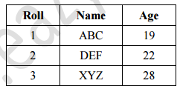
Cont…
Table or Relation: Collection of related records
https://beginnersbook.com/2015/04/e-r-model-in-dbms/
The columns of this relation are called Fields, Attributes or Domains. The rows are called Tuples or Records.

Slide 8
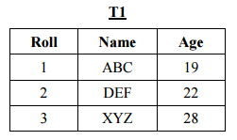
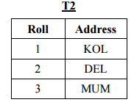
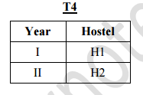
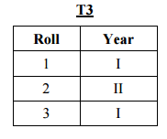
Cont…
Database: Collection of related relations. Consider the following collection of tables:
https://beginnersbook.com/2015/04/e-r-model-in-dbms/

Slide 9
Files and Databases
File: A collection of records or documents dealing with one organization, person, area or subject (Rowley)
Manual (paper) files
Computer files
Database: A collection of similar records with relationships between the records (Rowley)
Bibliographic, statistical, business data, images, etc.

Slide 10
Purpose of DBMS
In the early days, database applications were built directly on top of file systems
Drawbacks of using file systems to store data:
Data redundancy and inconsistency
Multiple file formats, duplication of information in different files
Difficulty in accessing data
Need to write a new program to carry out each new task
Data isolation — multiple files and formats
Integrity problems
Integrity constraints (e.g. account balance > 0) become “buried” in program code rather than being stated explicitly
Hard to add new constraints or change existing ones

Slide 11
Cont…
Drawbacks of using file systems (cont.)
Atomicity of updates
Failures may leave database in an inconsistent state with partial updates carried out
Example: Transfer of funds from one account to another should either complete or not happen at all
Concurrent access by multiple users
Concurrent accessed needed for performance
Uncontrolled concurrent accesses can lead to inconsistencies
Example: Two people reading a balance and updating it at the same time
Security problems
Hard to provide user access to some, but not all, data
Database systems offer solutions to all the above problems

Slide 12
Importance of DBMS
It helps make data management more efficient and effective.
Its query language allows quick answers to ad hoc queries.
It provides end users better access to more and better-managed data.
It promotes an integrated view of organization’s operations -- “big picture.”
It reduces the probability of inconsistent data.
Data Independence
Efficient data access
Data integrity and security
Data administration
Concurrent access and crash recovery

Slide 13
Examples of Database application
Banking: all transactions
Airlines: reservations, schedules
Universities: registration, grades
Sales: customers, products, purchases
Online retailers: order tracking, customized recommendations
Manufacturing: production, inventory, orders, supply chain
Human resources: employee records, salaries, tax deductions

Slide 14
Database users
Data Base Administrator (DBA):-
Authorizing access to the database
Coordinating and monitoring its use
Acquiring software and hardware resources
Database designers are responsible for:
Identifying the data to be stored
Choosing appropriate structures to represent and store this data
System analysts
Determine requirements of end users
Application programmers
Implement these specifications as programs

Slide 15
Cont…
End users : People whose jobs require access to the database
Types
Casual end users: access database occasionally by sophisticated query language when needed.
(Manager)
Naive or parametric end users: they make up a large section of the end-user population. Learn only a few facilities that they may use repeatedly
(bank clerk)
Sophisticated end users: These include business analysts, scientists, engineers, others thoroughly familiar with the system capabilities.
Standalone users: Normal users

Slide 16
Database Administrator
Coordinates all the activities of the database system
has a good understanding of the enterprise’s information resources and needs.
Database administrator's duties include:
Schema definition
Storage structure and access method definition
Schema and physical organization modification
Granting users authority to access the database
Backing up data
Monitoring performance and responding to changes
Database tuning

Slide 17
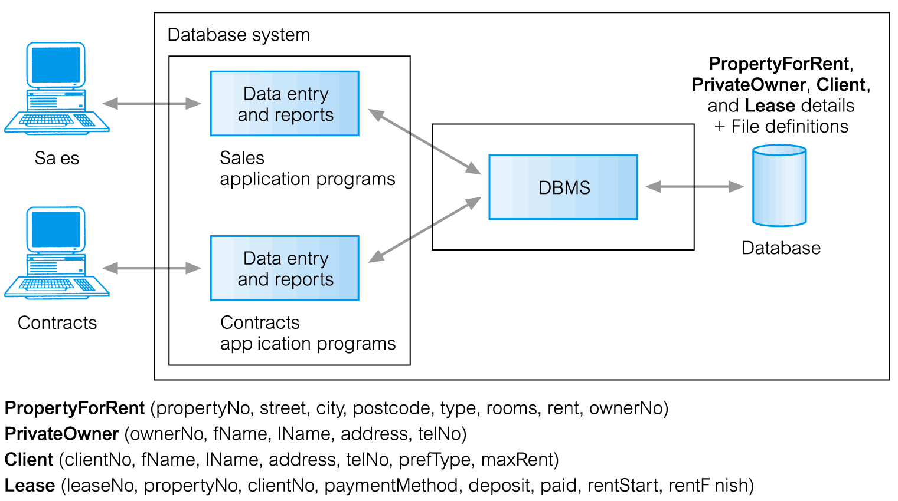
Database Management System(DBMS)
https://beginnersbook.com/2015/04/e-r-model-in-dbms/

Slide 18
Summary
In the early days, database applications were built directly on top of file systems but due to many drawbacks of the file systems there is a need for the paradigm shift from file systems to the Database Management Systems.

Slide 19
FAQs
Why the paradigm shift from file system to database system is important?
What is the importance of Database Management System?
List some of the applications of DBMS.
What is DBA?
What are the role and responsibilities of DBA.

Slide 20
References
RamezElmasri and Shamkant B. Navathe, “Fundamentals of Database System”, The Benjamin / Cummings Publishing Co.
Korth and Silberschatz Abraham, “Database System Concepts”, McGraw Hall.
C.J.Date, “An Introduction to Database Systems”, Addison Wesley.
Thomas M. Connolly, Carolyn & E. Begg, “Database Systems: A Practical Approach to Design, Implementation and Management”, 5/E, University of Paisley, Addison-Wesley.

Slide 21
THANK YOU
For queries
Email: shaveta.e13464@cumail.in

